Slide 1









Text Analytics
Beyond Bag of Words: Conditional Random Fields,
Word Embeddings, RNN
(FYI only, not included in the exam)
MSBA Fall 2019
12/02, 12/03
Dr. Anitesh Barua
David Bruton Jr. Centennial Chair Professor of Business
Distinguished Fellow, INFORMS Information Systems Society
Stevens Piper Foundation Professor
University of Texas Distinguished Teaching Professor
McCombs School of Business, University of Texas at Austin
Email: aniteshb@gmail.com
Source: http://blog.echen.me/2012/01/03/introduction-to-conditional-random-fields/

Slide 2
Conditional Random Fields
Predict multiple variables that depend on each other
  E.g., the performance of a sports team depends on the health of each member of the team
  Health of each member might get affected by the travel schedule of the team
  The results of a game might affect the morale of the team
  The morale, in turn, might affect the health
Many applications with unstructured data
  Text analytics
  Image analytics

Slide 3
POS Tagging Application
One of many applications of CRF
The goal is to label a sentence (e.g., a sequence of words or tokens) with tags like ADJECTIVE, NOUN, PREPOSITION, VERB, ADVERB, and ARTICLE.
x = He reckons the current account deficit will narrow significantly.
Label l = (PRP, VB, DT, JJ, NN, NN, MD, VB, RB)
Wish to predict sentence labels with CRF
Need to build “feature functions”

Slide 4
Feature Functions
A feature function is one that takes in as input:
a sentence s
the position i of a word in the sentence
the label l_{i} of the current word
the label l_{i−1} of the previous word
and outputs a real-valued number (e.g., 0 or 1)

Slide 5

Examples of Feature Functions

Slide 6
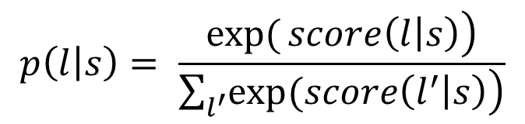
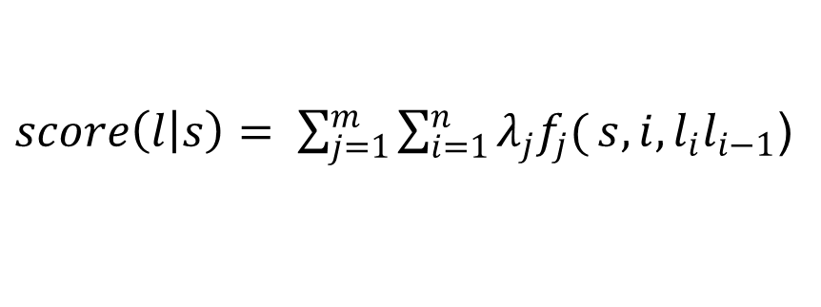
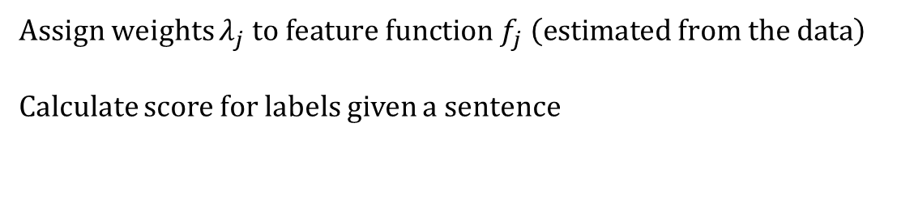
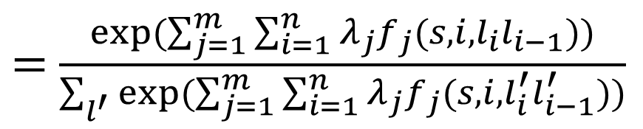
The CRF Model
Assign weights $λ_{j}{ to feature function f}_{j} \left(estimated from the data\right)$
Calculate score for labels given a sentence
$score\left(l | s\right)= \sum_{j=1}^{m}{\sum_{i=1}^{n}{λ_{j}f_{j}(}}s,i,l_{i}l_{i−1}$)
Take exponent and normalize to convert into probabilities
$$p\left(l | s\right)= \frac{\left.\exp{(}score\left(l | s\right)\right)}{\sum_{l^{′}}{\left.exp⁡(score\left(l^{′} | s\right)\right)}}$$
$=$ $\frac{exp⁡(\sum_{j=1}^{m}{\sum_{i=1}^{n}{λ_{j}f_{j}(}}s,i,l_{i}l_{i−1}))}{\sum_{l^{′}}{exp⁡(\sum_{j=1}^{m}{\sum_{i=1}^{n}{λ_{j}f_{j}(}}s,i,l_{i}^{′}l_{i−1}^{′}))}}$

Slide 7
Looks Like ….?

Slide 8
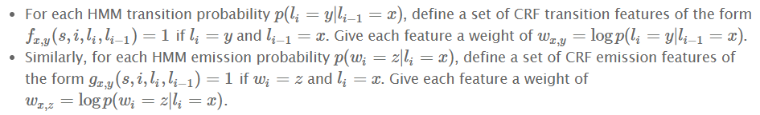
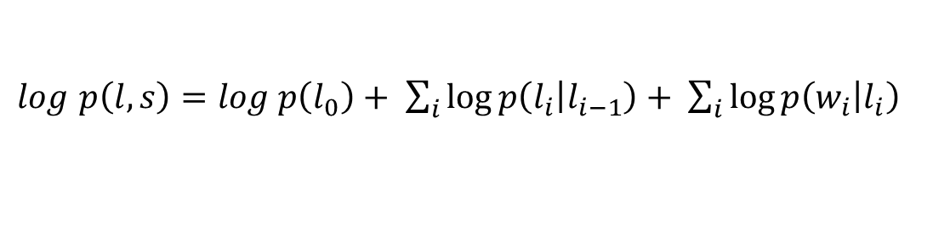
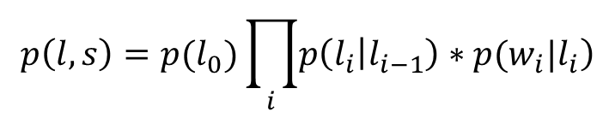
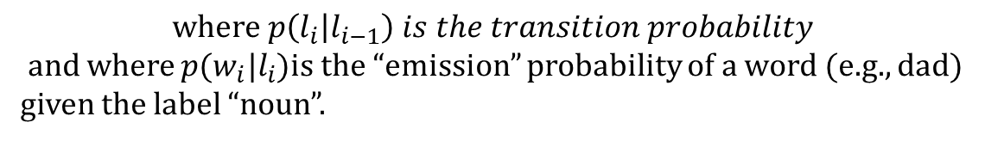
Smells Like …. Hidden Markov Models (HMM)?
A generative model
$$p\left(l,s\right)=p(l_{0})\prod_{i}{\left.p\left(l_{i} | l_{i−1}\right)∗p(w_{i}|l_{i}\right)}$$
$$where p\left(l_{i} | l_{i−1}\right) is the transition probability$$
and where $p(w_{i}|l_{i}$)is the “emission” probability of a word (e.g., dad)
given the label “noun”.
$log$ $p\left(l,s\right)=log p\left(l_{0}\right)+ \sum_{i}{\log{p\left(l_{i} | l_{i−1}\right)}}+ \sum_{i}{\log{p\left(w_{i} | l_{i}\right)}}$
Correspondence with CRF?

Slide 9
Word Embeddings: Deterministic, CBOW & Skip-Gram
Source: https://www.analyticsvidhya.com/blog/2017/06/word-embeddings-count-word2veec/

Slide 10
Co-occurrence and Context Window
Moving away from single words in isolation
E.g., CRF (logistic based)
Similar words tend to occur together
Will have similar context
Apple is a fruit. Mango is a fruit.
Have the similar context – fruit.
Context window: “radius” (# words) around a word.

Slide 11
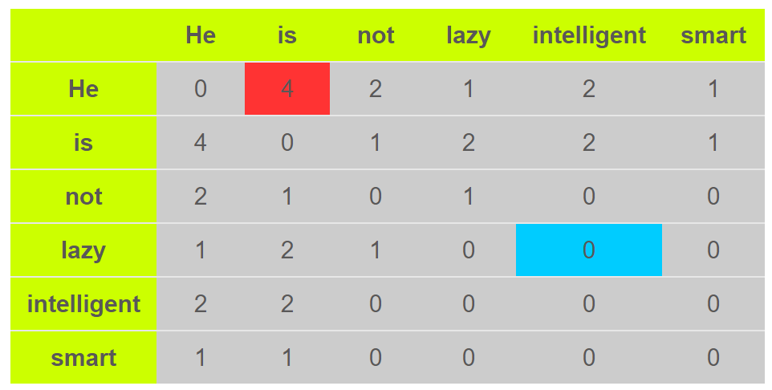
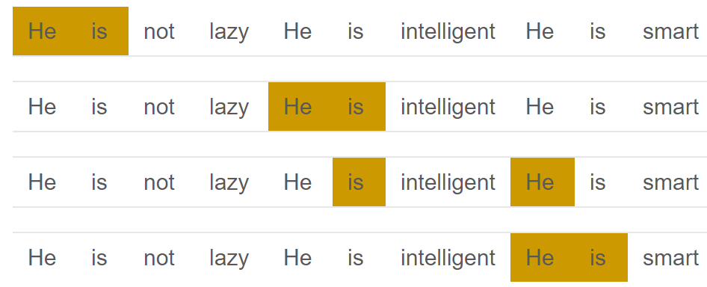
Co-occurrence Matrix (not popular)
Document “He is not lazy. He is intelligent. He is smart.” (Context window=2)
Perform PCA, decompose into 3 matrices – 2 for word vector and 1 for context

Slide 12
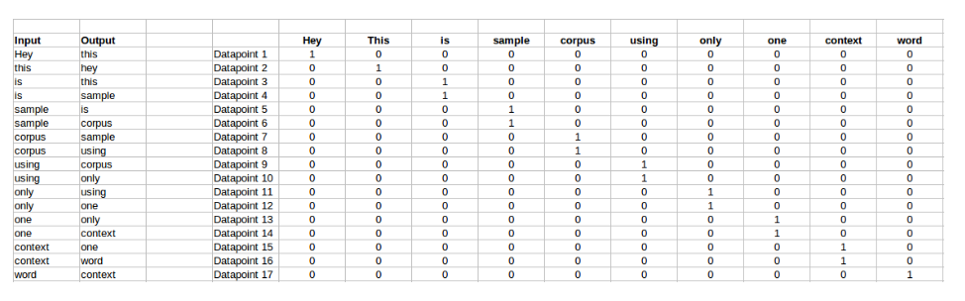
Probabilistic Approaches with Neural Networks: Continuous Bag of Words (CBOW)
Predicts the probability of a word given a context
Context: Single word or a group of words
Predict a single target word
One-hot encoding
Document: “Hey this is sample corpus using only one context word.”
Note: The above table missed Input:This & Output: is

Slide 13
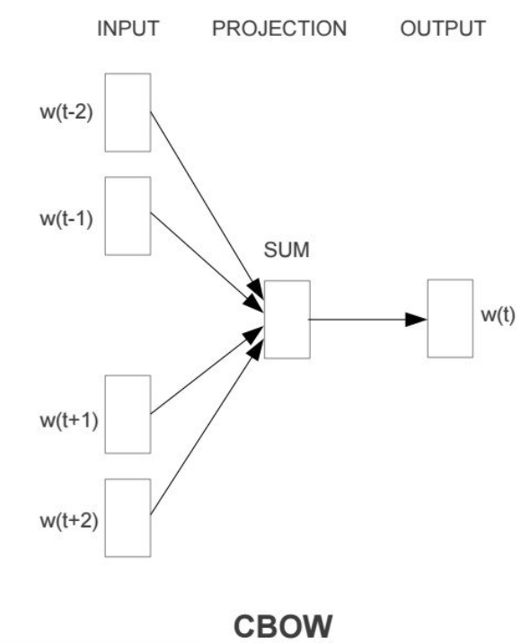
Neighborhood (Context) & Window Size
Window size=2
Predict w(t)

Slide 14
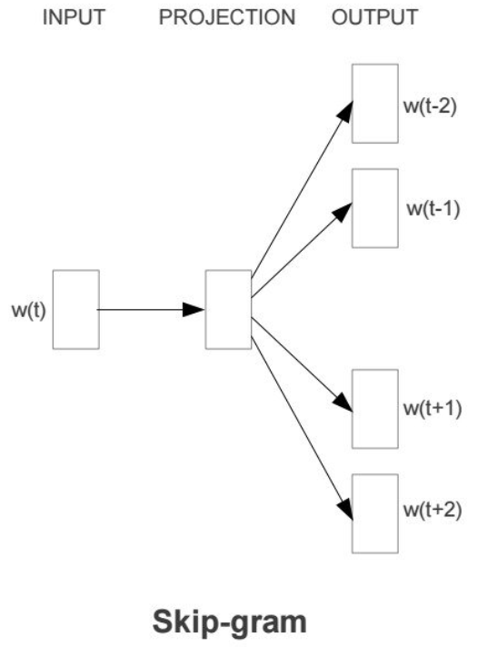
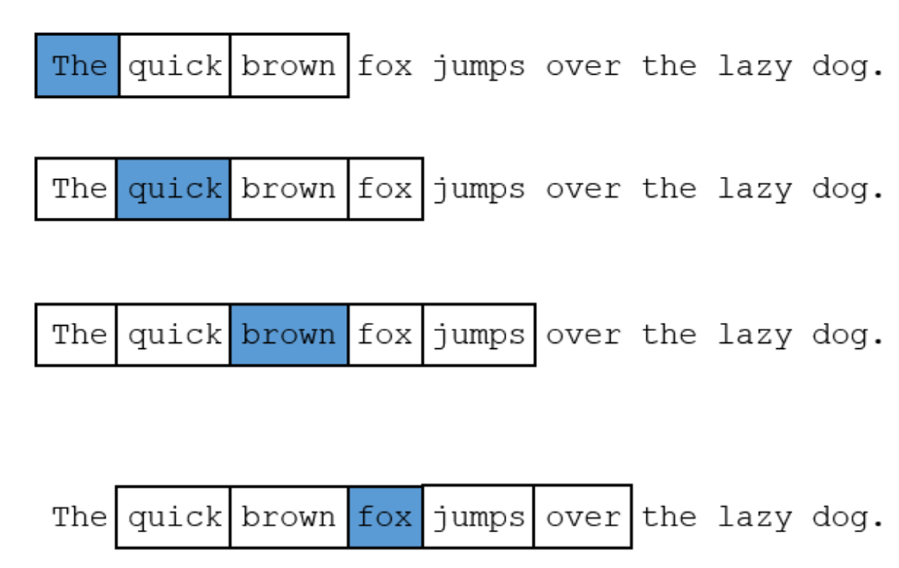
The Skip-gram Model
Inputs to a neural network

Slide 15
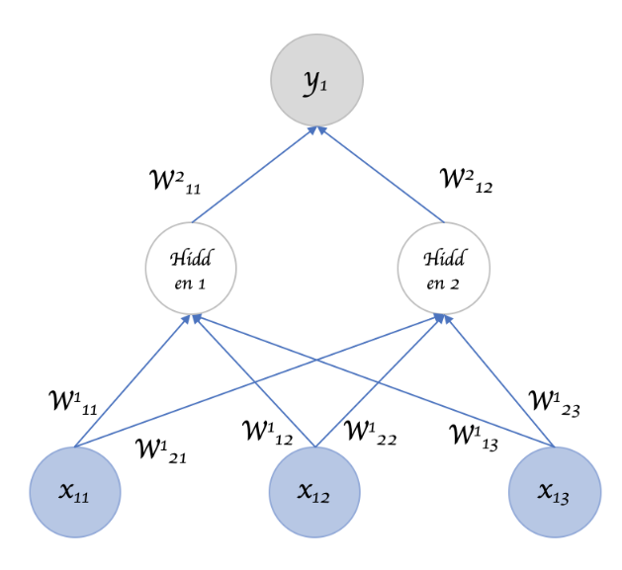
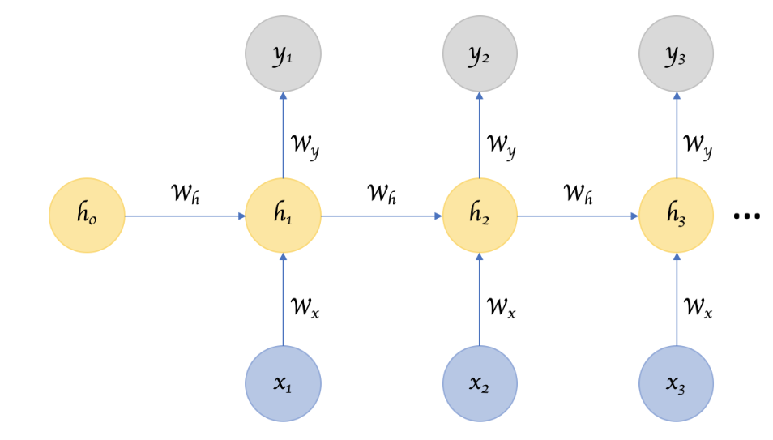
Recurrent Neural Networks (RNN)
RNNs remember things learnt from prior input(s)
Can take one or more input vectors and produce one or more output vectors
Output(s) influenced by a “hidden” state vector (context)
Same input can produce a different output depending on previous inputs
LSTMs are related to RNN, but change the calculation of outputs and hidden state

Slide 16
Automatic Extraction of Features of Mobile Apps from Version Release Notes
Adobe Reader is now Adobe Acrobat DC. The most reliable PDF viewer for mobile, with added functionality to help you work on the go. (Adobe Reader App)
Simply go to the profile page, tap on the Login into facebook button. Now you you will have access to all your fb friends. (ihatch App)
Send cards via fb messenger and g+ (ecard App)
Improved handling of large msg files (Klammer App)
Notes:
Irrelevant information:
Adobe Reader is now Adobe Acrobat DC. The most reliable PDF viewer for mobile, with added functionality to help you work on the go.
Different words 'facebook' and 'fb' to refer same thing written in the same version release probably by the same developer.
Simply go to the Profile Page, tap on the Login into facebook button. Now you you will have access to all your fb friends.
Different meanings same word - 'msg'. Usually, msg is a short form of message, but in the below sentence, it is a file format (outlook mail files have .msg extension).
Improved handling of large msg files
Sample version release note (in the next slide) could be used as an example of sentences with less grammatical structure.
- User interface improvements.

Slide 17
Sample Version Notes
“Greatly improved Voice Over support for visually impaired users. - Retina display support for iPhone & iPad - User interface improvements. Added a recording signal meter - Support for system and remote - Control of media playback and recording such as lock screen, and system media controls.”

Slide 18
Challenges & Solutions
Challenges | Solution
Bi- & tri-gram features: Representing the order of feature words | BIOES tagging
No external dictionaries (non-static features with different names for same features) | Custom word embeddings: Skip-gram with negative sampling (Mikolov et al. 2013) for all words in our corpus
Large number of uninformative sentences | Sentence classifier (BiLSTM)
Learning the order of feature words | BiLSTM-Conditional Random Fields (CRF)
Notes:
Word embeddings are used to represent the words with context.
Words which have similar meaning have similar word embeddings.
Publicly available embeddings are not suitable for our data
Ex: Glove embeddings (Pennington et al. 2014) are built using Google news data
‘ui’, ‘drive’, ‘import’ might be used in different context in the news
Build our own word embeddings

Slide 19
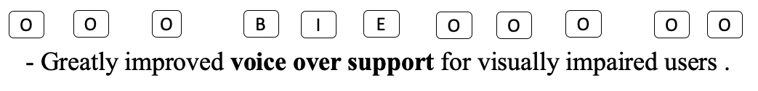
Feature Extraction: BIOES Tagging
BIOES format (Ratinov and Roth 2009) to represent the order of words

Slide 20
Why BiLSTM-CRF for Feature Identification?
BiLSTM
  Not suitable for bi- or tri-gram features
Output of BiLSTM is provided as an input to Conditional Random Fields (CRF), a probabilistic graphical model (Sutton and McCallum, 2012)
  CRF predict a probability for all the labels (BIOES) for each word in a given sentence utilizing the global context provided by the Bi-LSTM
  Dynamic programming to obtain a sequence of labels with the highest probability across all words in a sentence (Russell and Norvig, 2016).

Slide 21
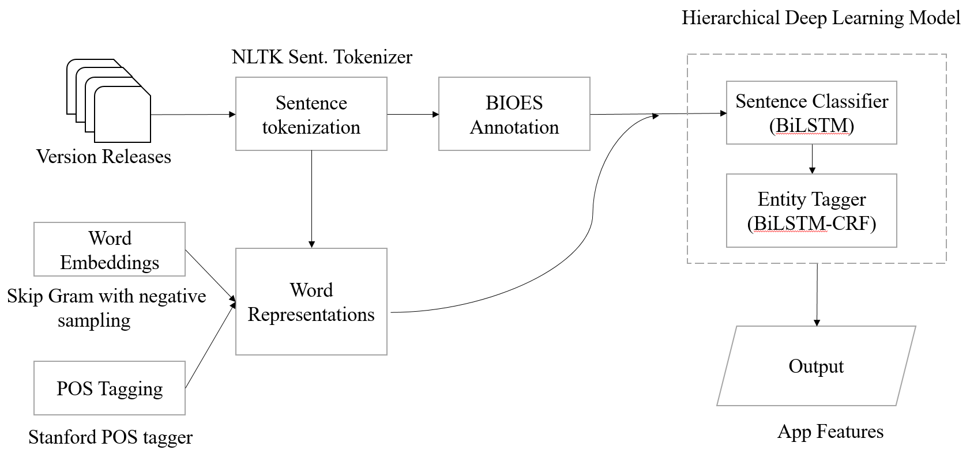
Flowchart of Our Feature Extraction Procedure
Character Embeddings
Notes:
We use character level embeddings of a word along with word embeddings for three major reasons. One, developers name features using alphanumeric and special characters. For instance, words like g+, 3d touch, 3g, 4g, etc. are used as features of an app. Second, developers may provide unique names for app features, and word embeddings are well equipped in handling frequently observed words. Third, word forms or linguistic information like prefix and suffix notation of a word would have information in identifying the feature words. For example, ‘browser’ is a feature word, but ‘browse’ is a non-feature word. We use character embeddings to overcome these challenges.

Slide 22
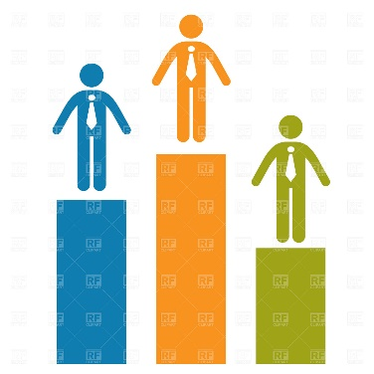
“Us and Them”
Method | f1 | Precision | Recall | Comments
Noun & verb phrase extraction | 19.7% | 39.1% | 34.3%
BiLSTM (Liu et al. 2019) | 40.5% | 45.9% | 47.4% | Not suited for bi- and tri-grams
BiLSTM-CRF | 57.6% | 65.4% | 51.5% | Non-feature sentences pose challenge
Our approach (hierarchical) | 75.5% | 70.5% | 81.3% | Works well with our noisy & sparse data

Slide 23
Comparing Feature Extraction Results
App | Version Release Notes | Actual Features | Predicted Features (Our Approach) | Predicted Features (BiLSTM)
irecorder-pro-audio-recorder (version: 3.1) | - Greatly improved Voice Over support for visually impaired users. - Retina display support for iPhone & iPad - User interface improvements. Added a recording signal meter - Support for system and remote - Control of media playback and recording such as on lock screen, and system media controls. | (‘voice over support’, 'retina display', 'user interface', 'recording signal meter', 'media playback', ‘recording’, ‘lock screen’, 'media controls') | (‘voice over support’, ‘visually impaired users’, 'retina display', 'user interface', 'recording signal meter', 'media playback', 'lock screen', 'media controls') | (‘support’, ‘users’, ‘display', ’support’ ‘interface', ‘signal’, 'media’, ‘playback', ‘recording’, 'screen', 'media')
Yammer (Version: 6.5.14) | We are constantly making small fixes and improvements to the app, and, as always, many bugs were crushed during the creation of this release. Thanks for letting us know when things go wrong! Keep up the good work. We know we will.
Notes:
Hierarchical DL result:
‘Visually impaired users’, is predicted as a feature – false positive.
‘on lock screen’ – is not counted as a feature. Since it does not completely over lap with ‘lock screen’
It also misses out on ‘recording’
BiLSTM Result:
Except ’recording’, other features predicted by the BiLSTM in this example will be counted as a feature. Since, the annotated features span more than one word we look at the exact match of the words in the annotated version to that of the predicted version.
BiLSTM will be better in predicting one word features like ui, ux, drive, etc. but not two or three word features.

